Slide 1

LAPR2-Literature Presentation
Group 12 DC:
Daniel Monteiro;
Hugo Miranda;
Mário Borja;
Guilherme Marques;
Jorge Cunha;
Karysia Mendes.

Slide 2


Introduction
The Labs - Overall Description
Both laboratories that we selected have a major focus on cancer research, which we believe to be an important area.
The purpose of this report is to compare already existent management software on various laboratories to our own integrated projects program which is to be developed during the entire second semester.

Slide 3



The Laboratories
Cleveland Clinic Laboratory
Majumder Laboratory
… and their Management Software's

Slide 4


Analysis
Despite both laboratories working on cancer each one has a different specialization regarding that area.
The Majumder Laboratory works primarily on brain tumors and its research, having a close relation with genetics as well.
While Cleveland Clinic Laboratories as a wider variety of diseases such as breast cancer, head, neck cancer and other rare cancers.
Majumder Laboratory is a research laboratory which means it focuses mainly on research itself rather than providing the possibility of getting tested and diagnosed.
The Cleveland Clinic Laboratories gives out many services to the patients with cancer providing programs made so that it will help the patient.

Slide 5
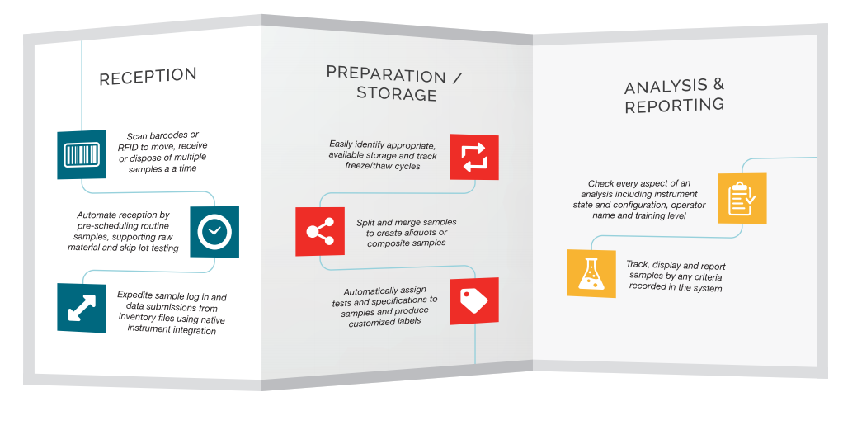
LIMS Management System
Cleveland Clinic Laboratory

Slide 6

Conclusion
-> Our group agreed that this type of research related to other ongoing projects was an overall success, especially when it brings several other benefits improving members performance along with it.
Some of the References:
->Cleveland Clinic Laboratory. https://my.clevelandclinic.org/health
->Cleveland Clinic Laboratory. https://my.clevelandclinic.org/departments

